Slide 1
Agency Prepayment: Refinance
September 2015

Slide 2
Outline
Introduction to Refinance
Description of Data
Empirical Observations and Comparisons
Description of Framework
Results
Spline Results
Tracking
Going Forward
Improved Credit Availability
Burnout

Slide 3
Introduction to Refinance
Refinance Definition
Refinance rate is the measure of the rate at which borrowers get a new loan with a lower interest rate. It does not include Turnover, Defaults or Curtailments.
Refinance Estimation
We split Refinance rates into 2 categories: media effect periods and non media effect periods
Media Effect periods are somewhat arbitrary to define, but largely these periods can be determined fairly easily by graphing the historical refinance rates over time. Periods with large spikes in refinance rates are media effect periods
Non Media Effect periods are periods where refinance rates don’t exhibit the same volatile and large spikes in refinance rates
Additionally our first estimates will rely on data prior to 2007, as we don’t want to include the mortgage crisis in step 1 of our estimation process
Refinance Incentive
An accurate measure of refinance incentive is important for the analysis of refinance rates
We are using the Freddie Survey Rate with adjustments for PMI and LLPA

Slide 4
Description of Refinance Data
Prepay Data
Pool Level
Prepayment information available for Fannie and Freddie pools
~ 750K pools with data as far back as 1994
Loan Level
Refinance information available for Fannie and Freddie loans
~ 26M loans with data as far back as 2006
Credit Data
Prepayment information available for Fannie and Freddie loans
~ 36M loans with data as far back as 1999
Has indicators for Prepayment, and Default
Excellent coverage for FICO, DTI, CLTV (msa level), Occupancy, etc.

Slide 5
Empirical Observations and Comparisons

Slide 6
Empirical Observations and Comparisons

Slide 7
Empirical Observations and Comparisons
Media Effect Measures
Refinanceable Universe
The percent of the universe that is 50bp in the money (ITM)
Periods of high refinanceable percentage should see higher refinance rates
Delta PMMS
A lookback over historical interest rates to see if the current rate is at a 2 year low
Periods where rates are reaching 2 year lows should see higher refinance rates
Credit Availability Measures
2 Year Moving Average of HPA
A 2 year moving average of HPA
Periods where HPA is positive over a 2 year time frame will have access to more credit which will allow for higher refinance rates
Cello Credit Availability Measure
Issue: can we forecast?

Slide 8
Empirical Observations and Comparisons

Slide 9
Empirical Observations and Comparisons

Slide 10
Empirical Observations and Comparisons

Slide 11
Empirical Observations and Comparisons

Slide 12
Description of Framework
Overview
After removing turnover, defaults and curtailments, all prepayments correspond to refinancing. The modeling strategy is to:
1) Fit an initial S-Curve based on non-media effect periods prior to 2007
2) Fit a media effect multiplier on all periods prior to 2007
3) Fit a credit availability multiplier on all periods available
4) Layer in other effects: WALA Ramp, Burnout, Loan Size, Occupancy Type, etc
Data
Query the pool and loan level data from IQ
Aggregate the Refinance data by loan characteristics:
Incentive, Media Measure, Credit Availability, WALA, etc.
R Program
Estimate initial S-Curve, followed by Media Effect, then Credit Availability
Layer in other loan effects: WALA, Loan Size, etc
Output
S-Curve Spline + Media Effect and Credit Availability multipliers + Loan Characteristic multipliers, which allow us to calculate an SMM given a set of loan characteristics

Slide 13
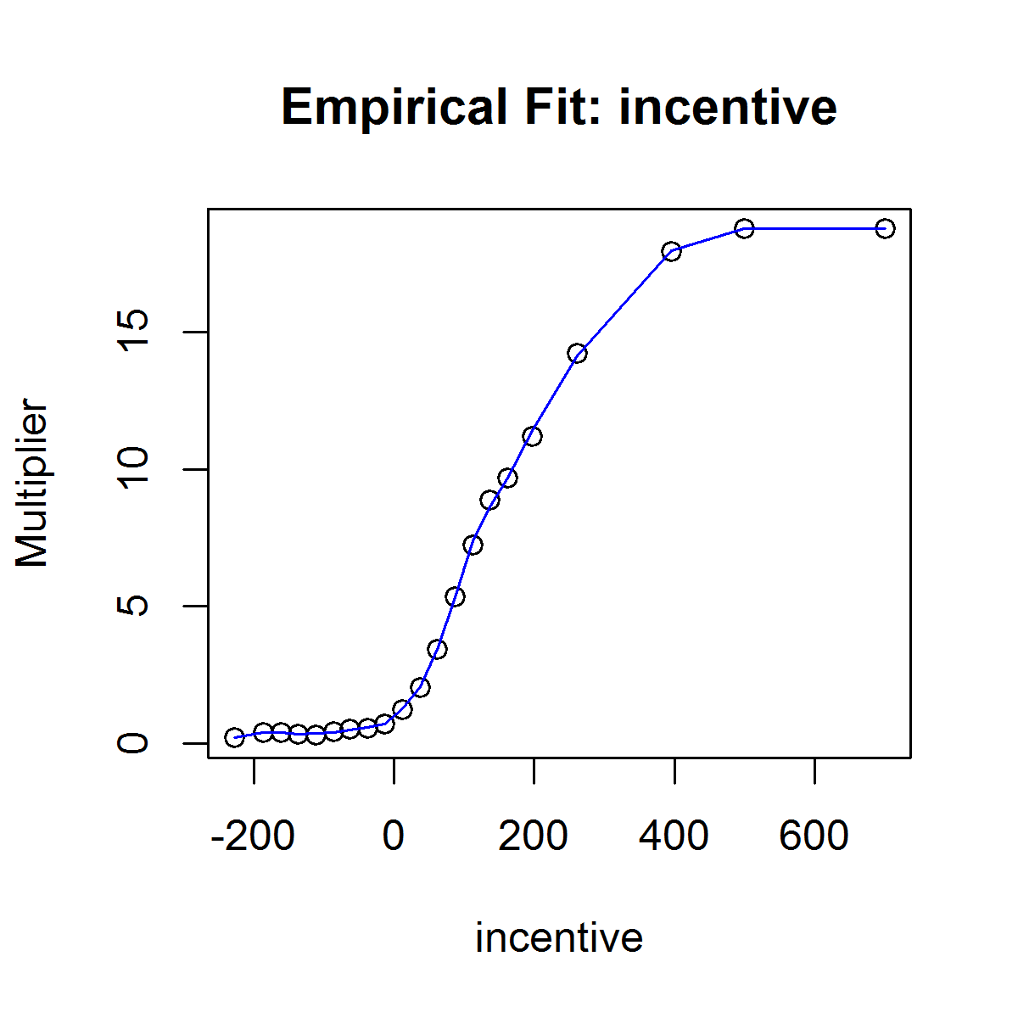
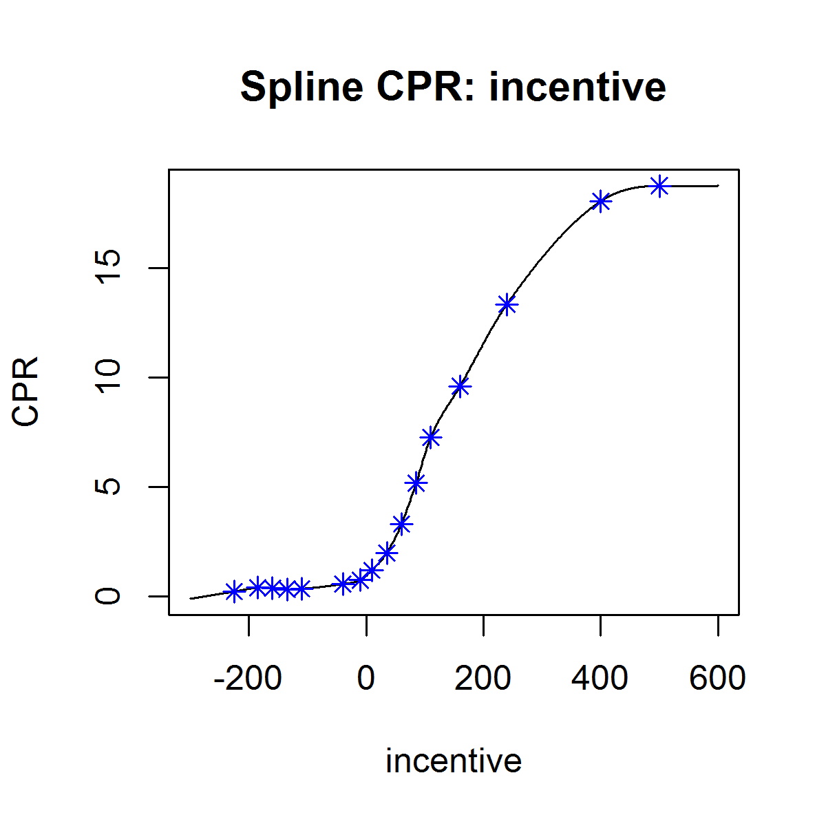

Results: Initial S-Curve

Slide 14
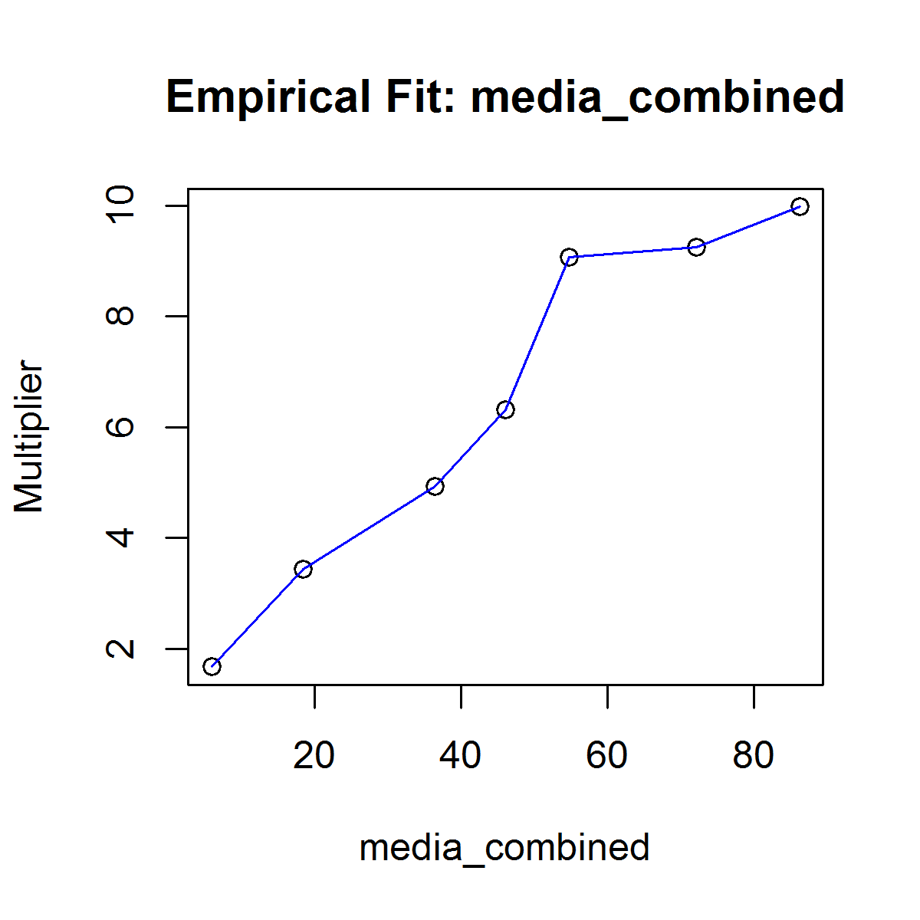
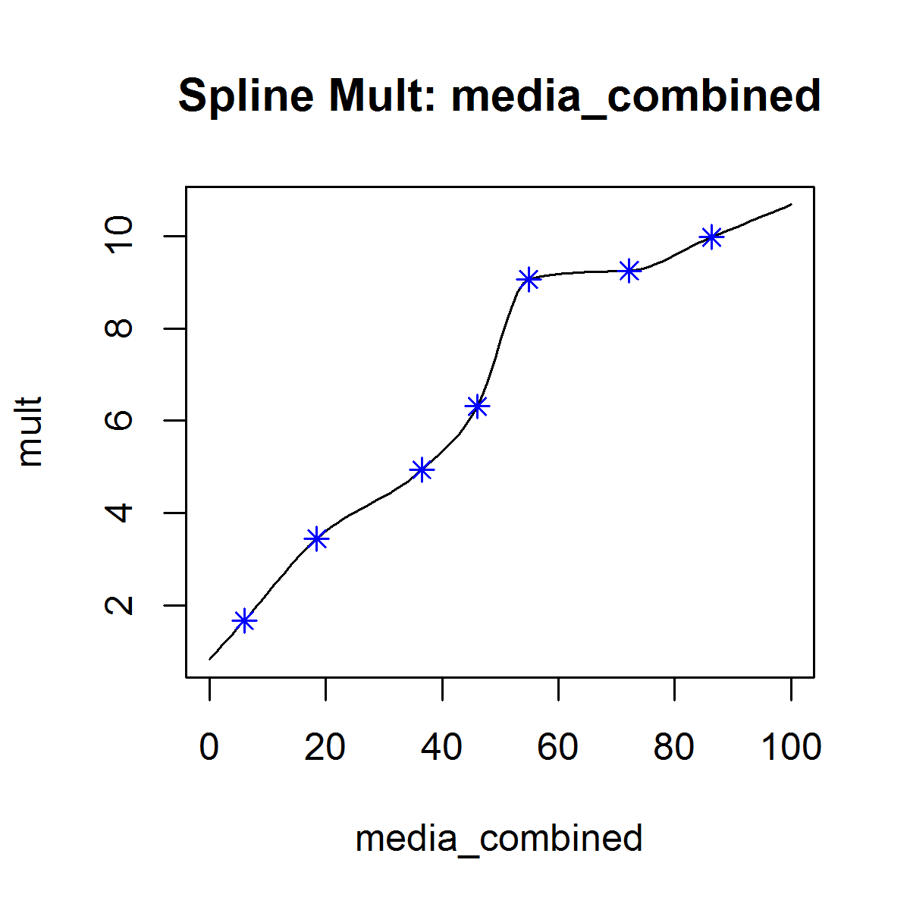
Results: Media Effect Multiplier

Slide 15
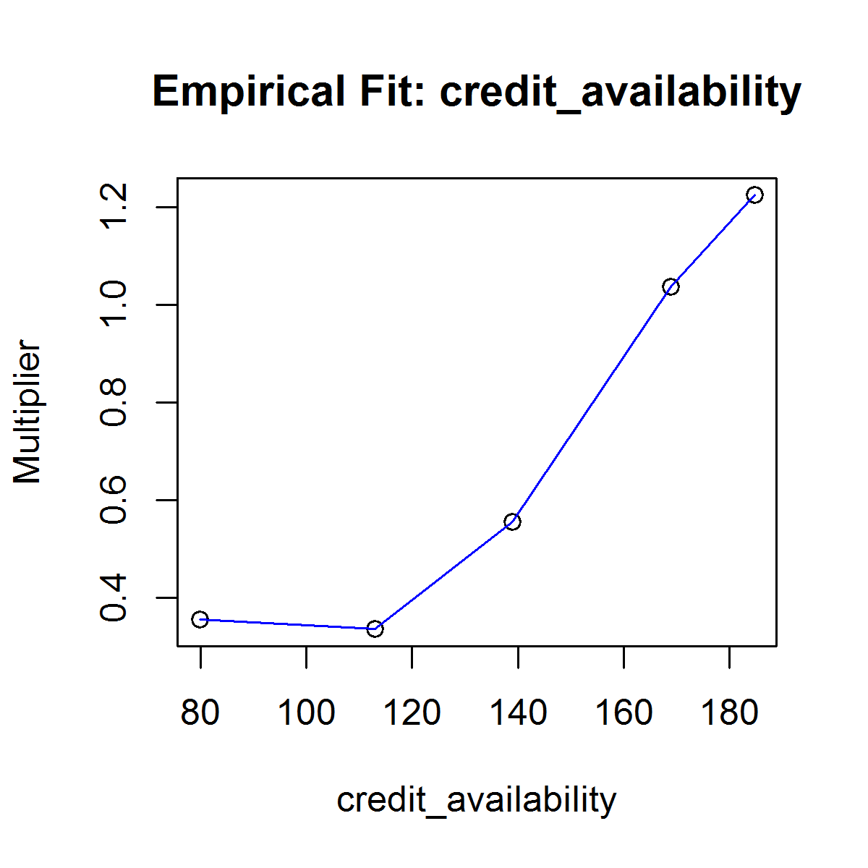
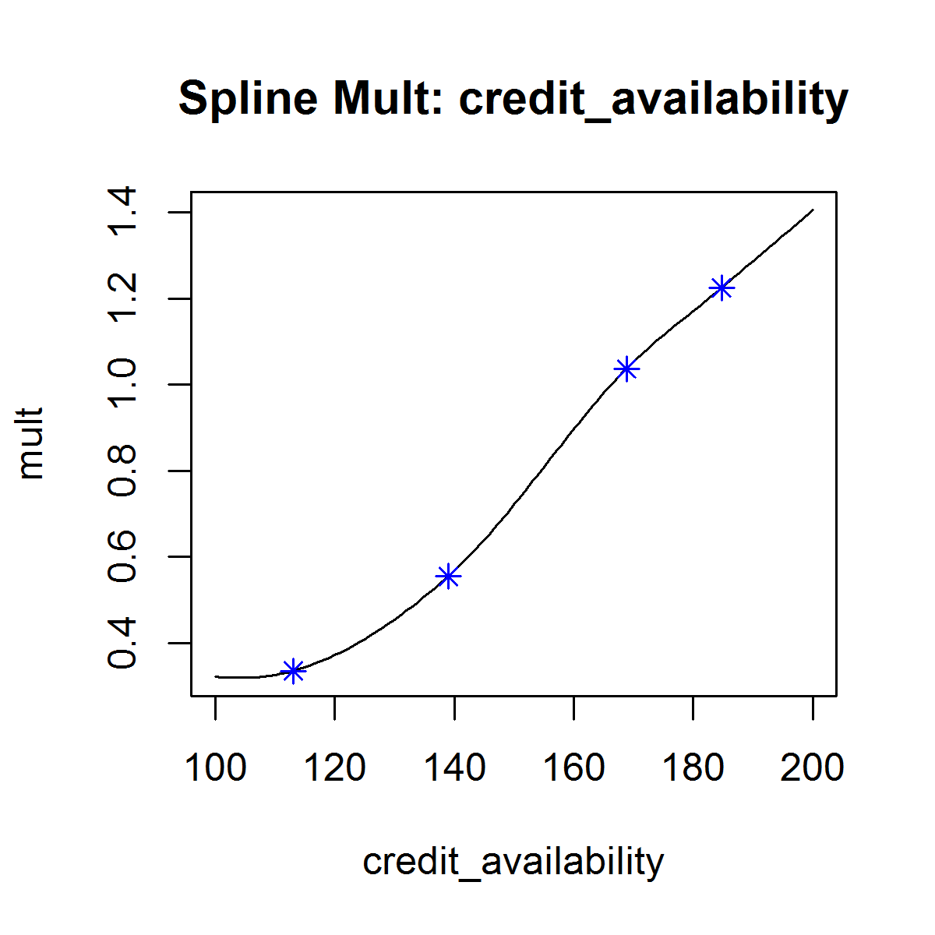
Results: Credit Availability Multiplier

Slide 16
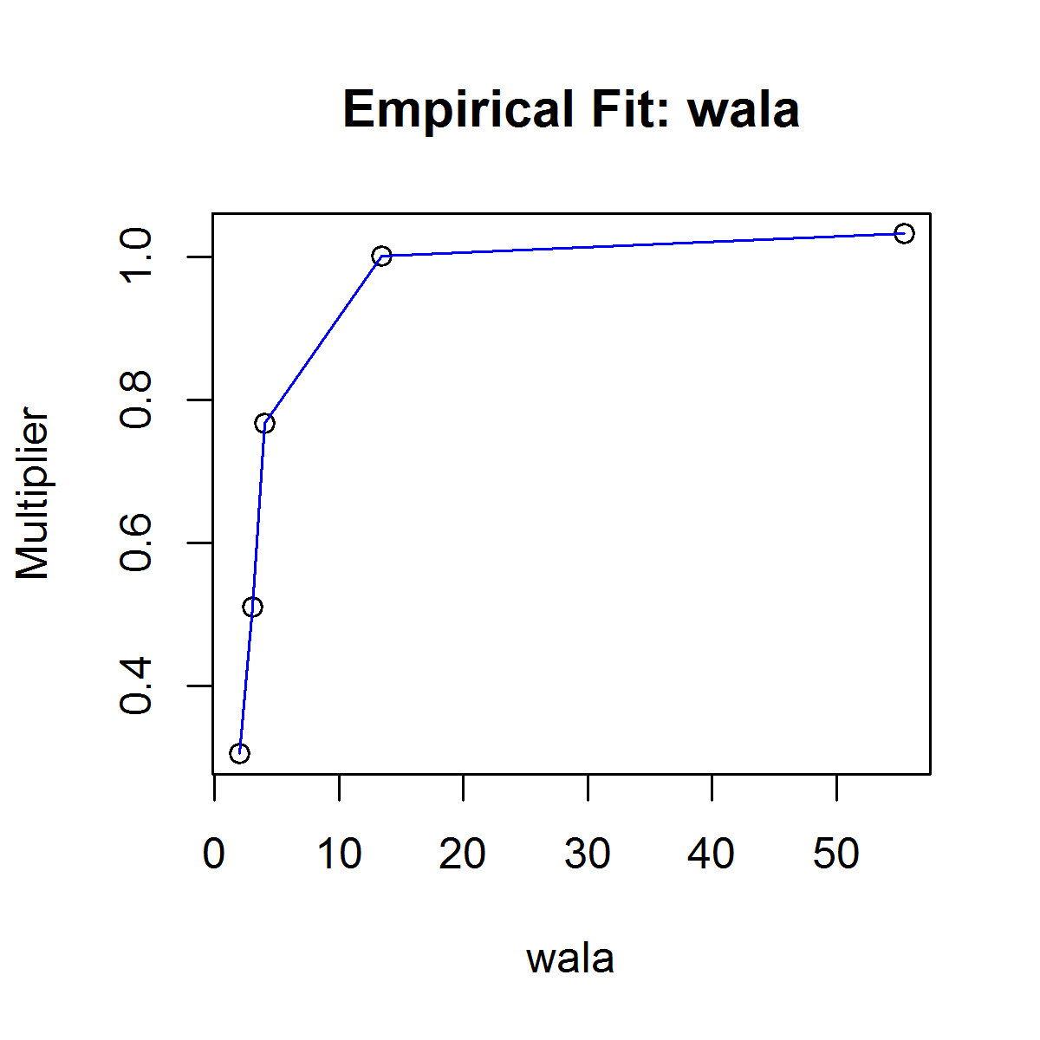
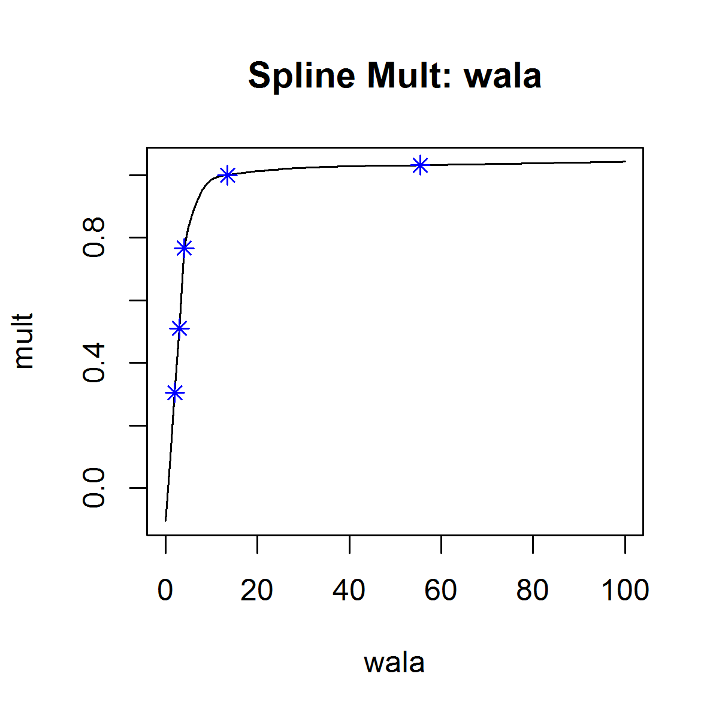
Results: Wala Ramp Multiplier

Slide 17
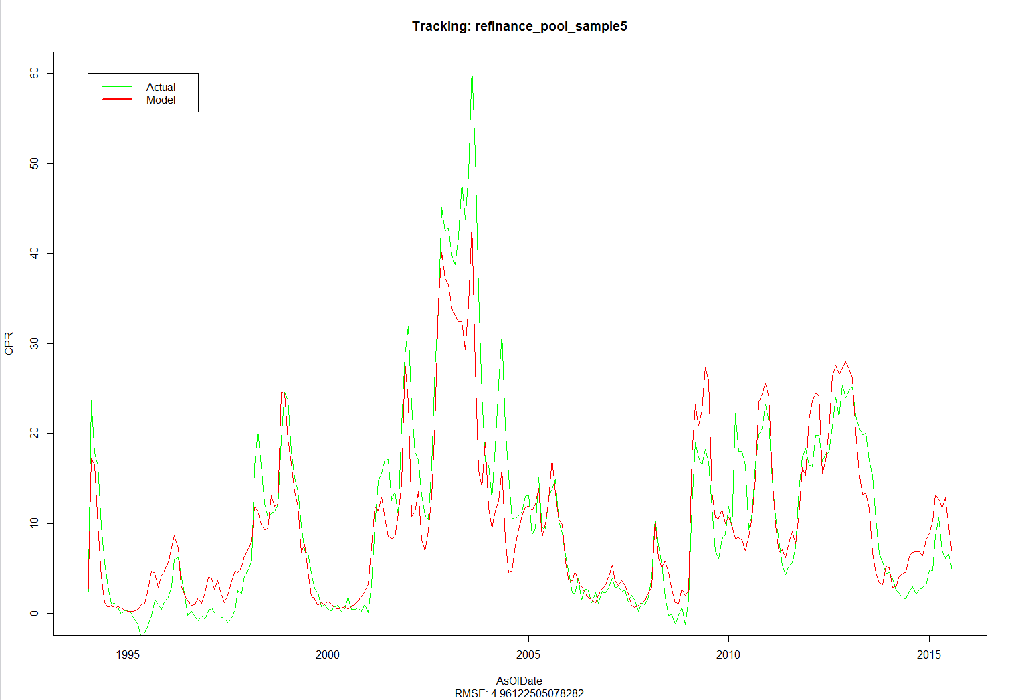
Tracking: Multiplicative Regression Model

Slide 18
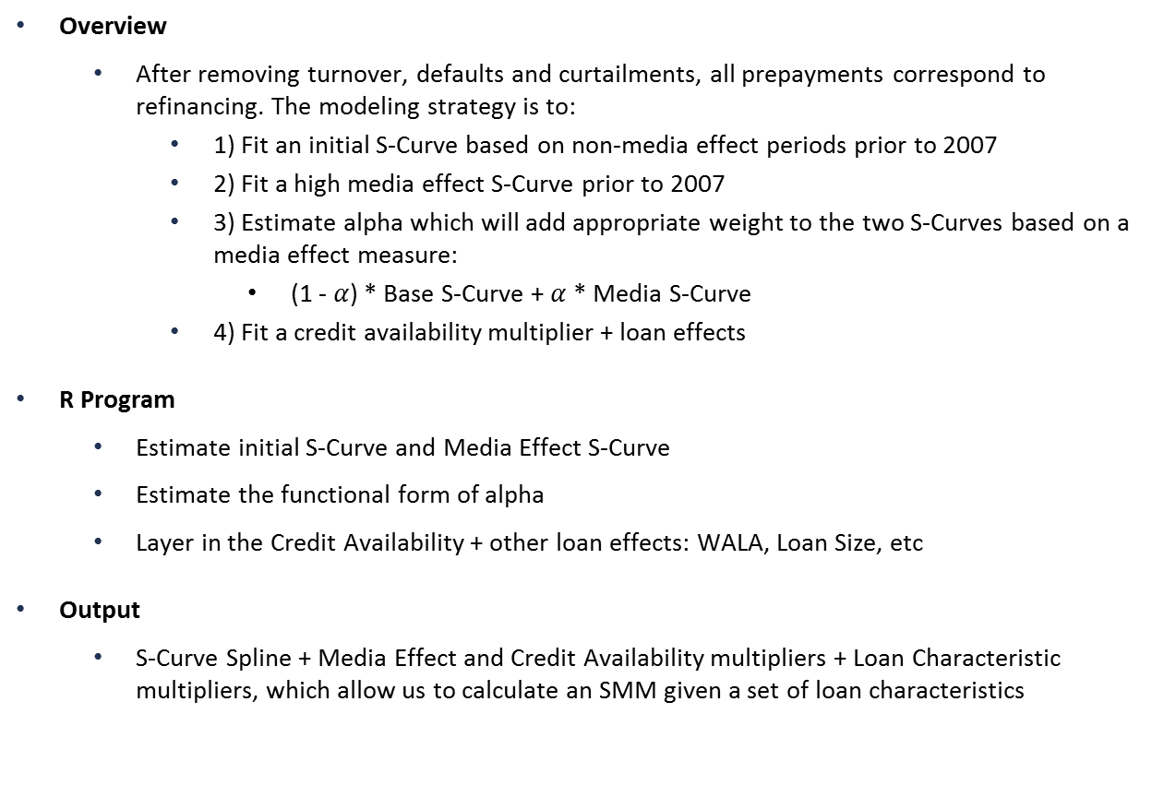
Alternative Specification: Alpha Estimate
Overview
After removing turnover, defaults and curtailments, all prepayments correspond to refinancing. The modeling strategy is to:
1) Fit an initial S-Curve based on non-media effect periods prior to 2007
2) Fit a high media effect S-Curve prior to 2007
3) Estimate alpha which will add appropriate weight to the two S-Curves based on a media effect measure:
(1 - $α$) * Base S-Curve + $α$* Media S-Curve
4) Fit a credit availability multiplier + loan effects
R Program
Estimate initial S-Curve and Media Effect S-Curve
Estimate the functional form of alpha
Layer in the Credit Availability + other loan effects: WALA, Loan Size, etc
Output
S-Curve Spline + Media Effect and Credit Availability multipliers + Loan Characteristic multipliers, which allow us to calculate an SMM given a set of loan characteristics

Slide 19
Results: Non Media S-Curve

Slide 20
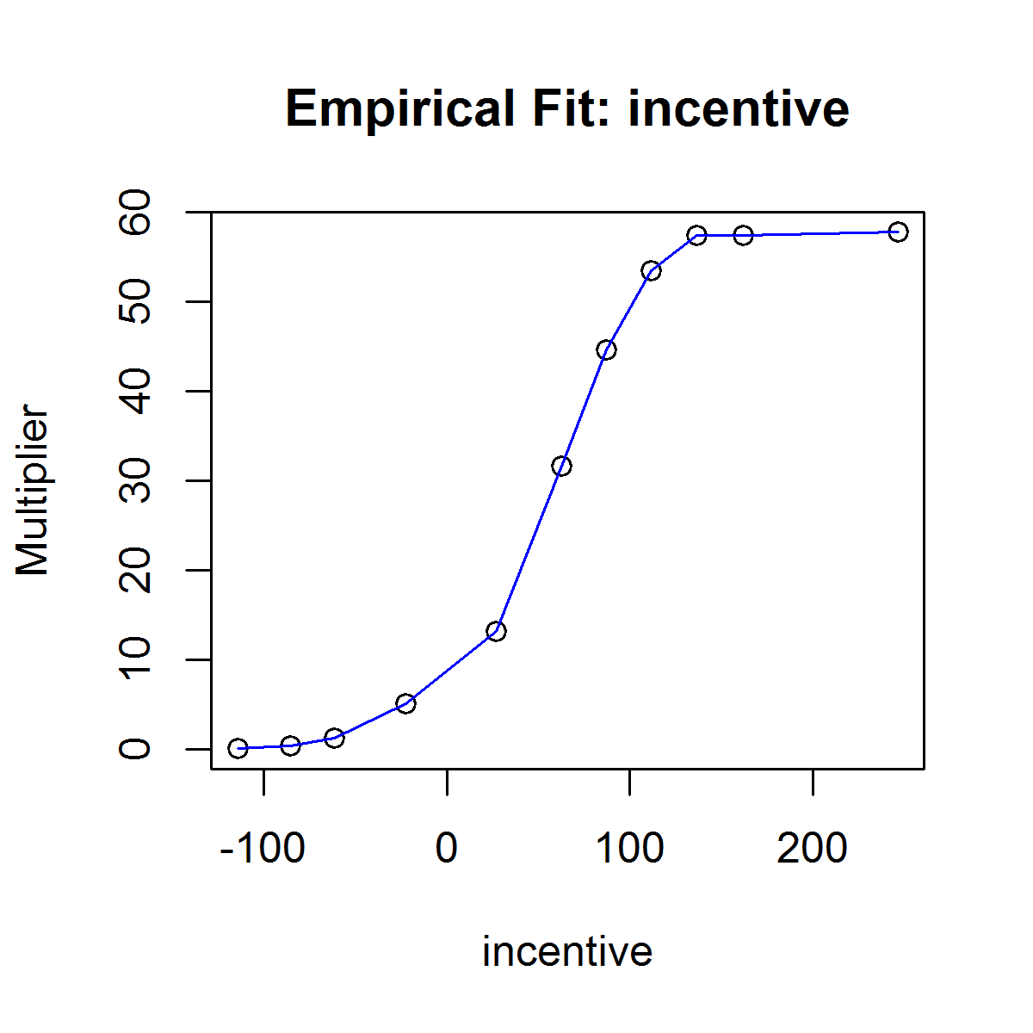
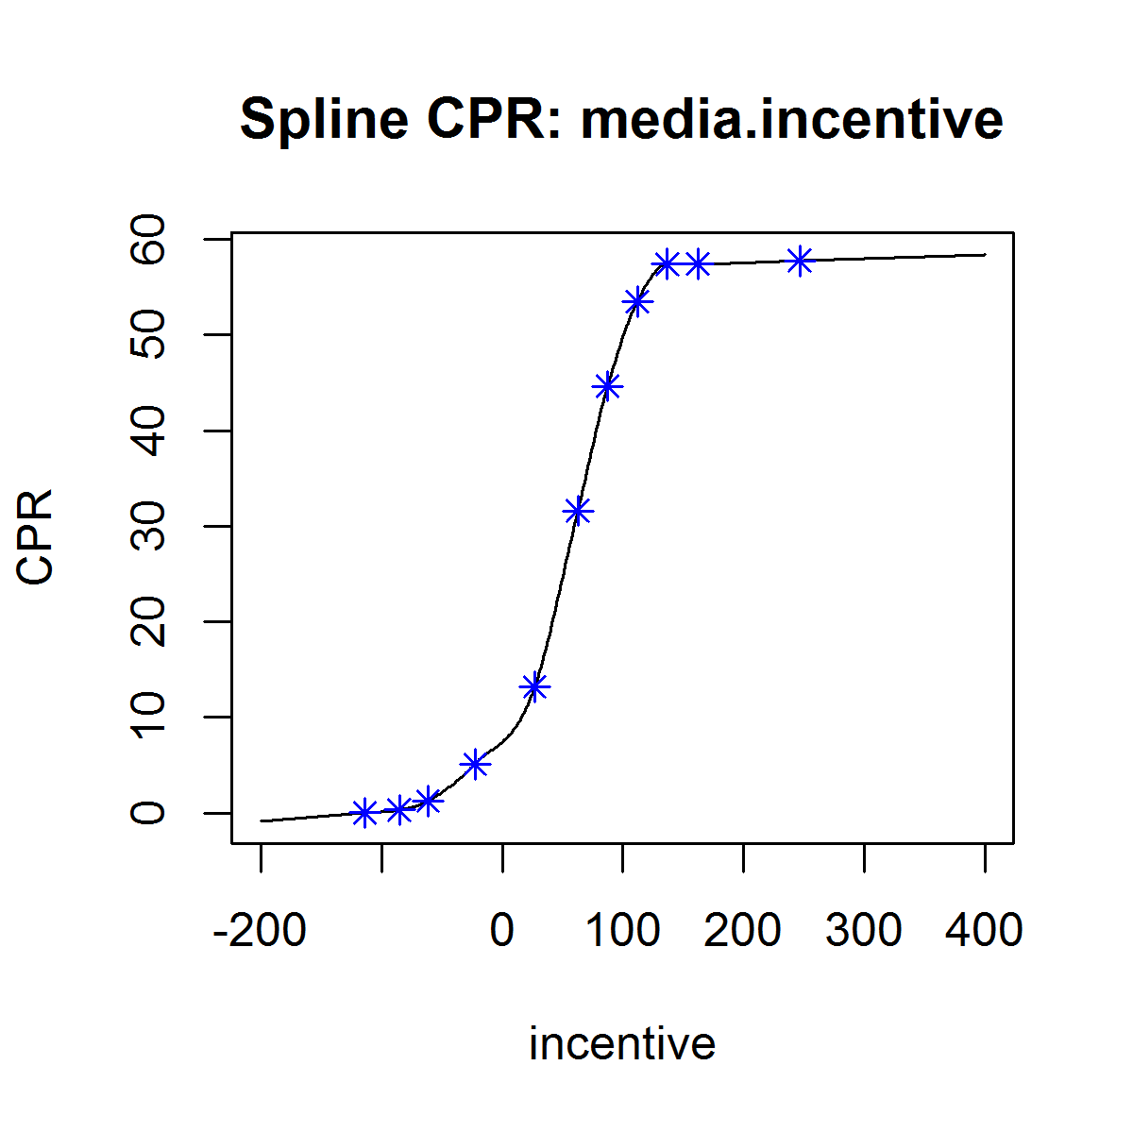
Results: High Media S-Curve

Slide 21
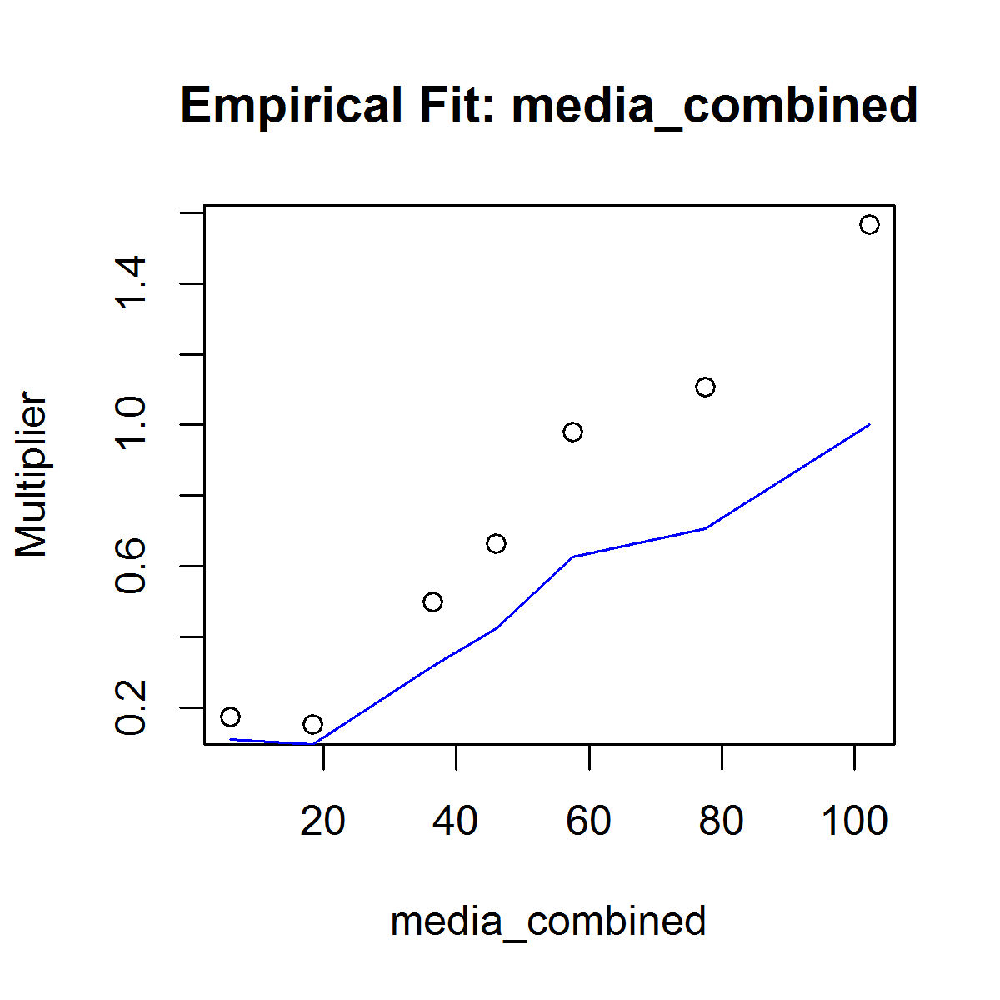
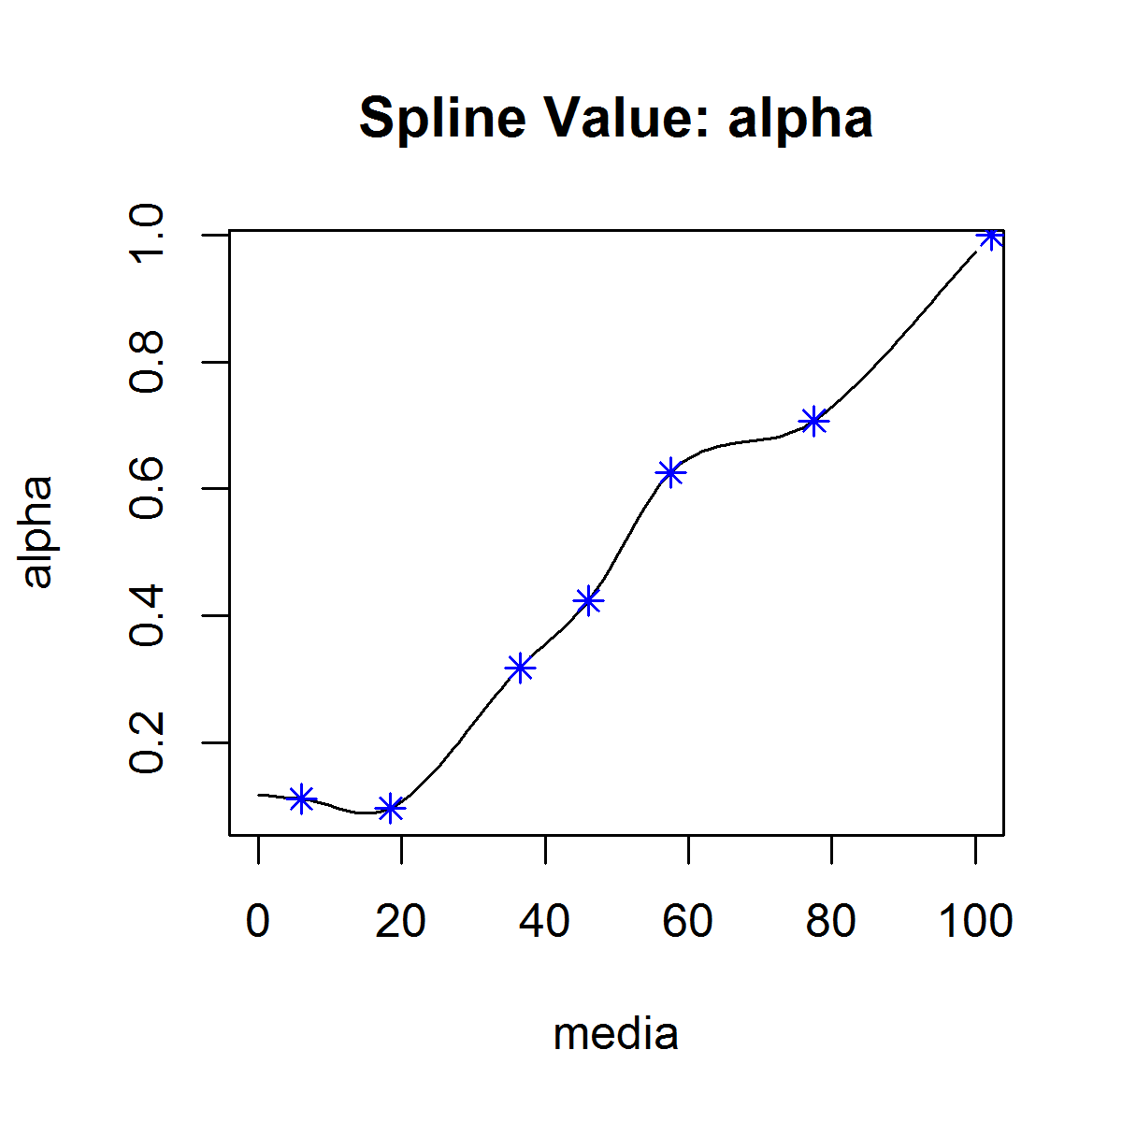

Results: Alpha Estimate

Slide 22
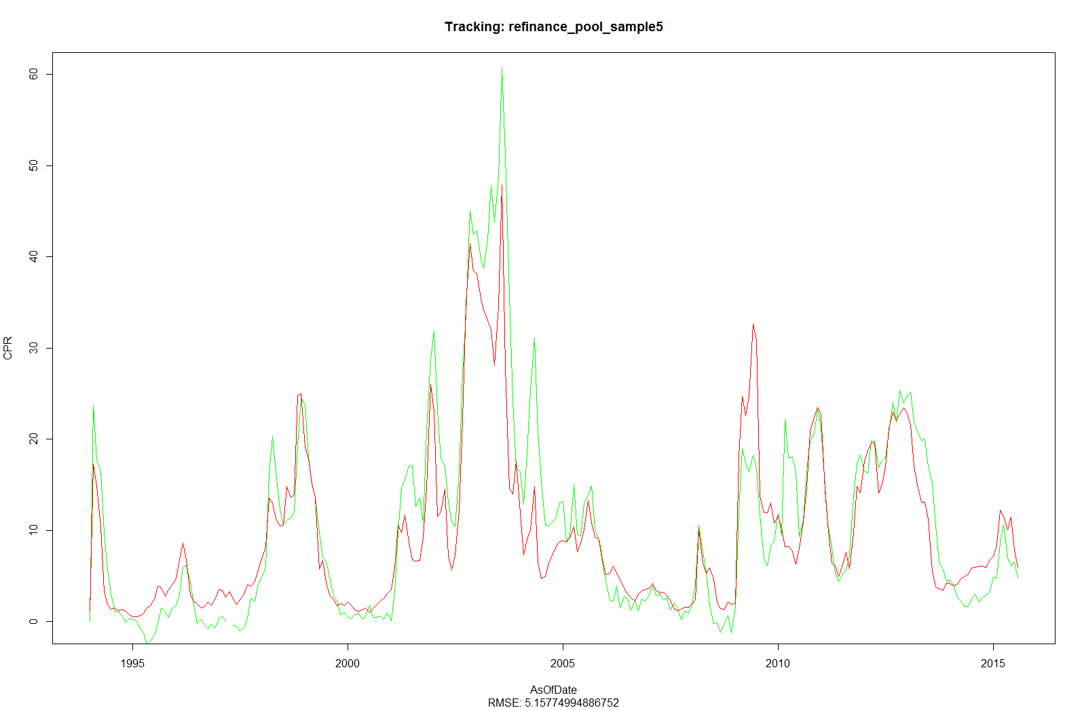
Tracking: Alpha Regression Model

Slide 23
Going Forward
Add Additional Effects for Loan Characteristics
Burnout
Loan Size
Occupancy

